Slide 1
Basic Statistical Methods
Session 1
02/11/2020

Slide 2
Statistics
Every minute of the working day, decisions are made by businesses around the world that determine whether companies will be profitable and growing or whether they will stagnate and die.
Most of these decisions are made with the assistance of information gathered about the market place, the economic and financial environment, the workforce, the competition and other factors.
Such information comes usually in the form of data or is accompanied by data.
Statistics provides the tool through which such data are collected, analyzed and summarized and presented to facilitate the decision making process.
For eg. a survey of 477 executives by The Association of Executive Search Consultants determined that 48% of the men and 67% of the women say they are more likely to negotiate for less business travel compared with five years ago.

Slide 3
Basic Statistical Concepts
Population: A collection of persons, objects or items of interest.
The population can be a widely defined category such as “all automobiles” or it can be narrowly defined such as “all Ford cars produced from 2016-2018”. A population can be a group of people such as “all workers presently employed by Microsoft”, or it can be a set of objects such as “all dishwashers produced on July 31,2018” by a specific manufacturing company.
When a researcher gather data from the whole population for a given measurement of interest, it is called Census.

Slide 4
Sample: A sample is a portion of the whole and is a representative of a whole population. Researchers often prefer to work with sample instead of entire population.
For example, to conduct a quality control experiment to determine the average life of light bulbs, a light bulb manufacturer might randomly sample say 75 light bulbs during a production run. A HR manager may take a random sample of only 10 employees instead of taking a whole employees to save time and money.
Descriptive Statistics: if a business analyst is using data gathered on a group to describe or reach conclusions about that same group, the statistics are called Descriptive.
Inferential Statistics: If a researcher gathers data from a sample and uses the statistics generated to reach conclusions about the population from which the sample was taken, it is inferential statistics.
One application of inferential statistics is in pharmaceutical research.

Slide 5
Parameter and Statistic
A descriptive measure of the population is called a parameter. Parameters are usually denoted by Greek letters. Examples of parameters are Population mean (μ), Population variance (σ²), and Population standard deviation (σ).
A descriptive measure of a sample is called a Statistic. These are usually denoted by Roman letters. Examples of Statistic are sample mean ( ) , sample variance (s²) and sample standard deviation(s).
A analyst often wants to estimate the value of a parameter or conduct test about a parameter. However the calculation of parameters usually either impossible or infeasible because of the amount of time and money required to take a census. In such cases, a business researcher can take a random sample of the population , calculate a statistic on the sample and infer by estimation the value of the parameter.

Slide 6
Variables and Data
Variable : In Statistics, a variable is a characteristic of any entity being studied that is capable of taking on different values. Some eg: are Return on investment, stock price, total sales, age of worker, time spent in shopping etc.
Data : Data are recorded measurement. A measurement is when a standard process is used to assign numbers to particular attributes or characteristics of a variable.

Slide 7
Concept of measurement
Measurement is the process of systematically assigning numbers to objects and their properties, to facilitate the use of mathematics in studying and describing objects and their relationships.
Some types of measurement are fairly concrete: for instance, measuring a person’s weight in pounds or kilograms, or their height in feet and inches or in meters.
Measurement is not limited to physical qualities like height and weight. Tests to measure abstractions like intelligence and aptitude are commonly used in education and psychology.

Slide 8
Data Measurement
Millions of numerical data are gathered in businesses everyday. All such data should not be analyzed the same way statistically because the entities represented by the numbers are different.
For this reason , the business researcher needs to know the level of data measurement represented by the numbers being analyzed.
There are four common levels of data measurements, namely
Nominal
Ordinal
Interval
Ratio

Slide 9
Nominal level
The lowest level of data measurement is Nominal level. Numbers representing nominal level data can be used only to classify or categorize.
Employee Identification Numbers is an example of Nominal data.
Many demographic questions in surveys result in data that are nominal because the questions are used to classify only. If we assign numbers 1, 2, 3 etc., these numbers should be only to use classify the respondents/items. The number 1 does not denote the top classification.

Slide 10
Ordinal Level
Ordinal level data measurement is higher than nominal level. In addition to nominal level capabilities, ordinal level measurement can be used to rank or order objects.
For example, using ordinal data, a supervisor can evaluate three employees by ranking their productivity with the numbers 1 trough 3. The supervisor could identify one employee as most productive, one as the least productive and one as somewhere between by using ordinal data.
However the supervisor could not use ordinal data to establish that the intervals between employees ranked 1 and 2 and between the employees ranked 2 and 3 are equal.ie, she could not say the differences in the amount of productivity between workers ranked 1, 2 and 3 necessarily the same.
Likert-type scale are considered by many researchers to be ordinal.

Slide 11
Levels of data measurement (contd…)
Session 2
04/11/2020

Slide 12
Interval Level
Interval level data measurement is next to the ordinal level of data in which distances between consecutive numbers have meaning and the data are always numerical.
The distances represented by the differences between consecutive numbers are equal.
An example of interval measurement is Fahrenheit temperature. With Fahrenheit temperature numbers, the temperature can be ranked, and the amounts of heat between consecutive readings, such as 38º, 39º and 40º are the same.
In addition, with interval level data, the zero point is a matter of convention or convenience and not a natural or fixed zero point. The zero does not mean the absence of the phenomenon.

Slide 13
Ratio Level
Ratio level data measurement is the highest level of data measurement. Ratio data has the same properties of interval data, but ratio data have an absolute zero, and the ratio of the two numbers is meaningful.
The notion of absolute zero means that zero is fixed, and the zero value in the data represents the absence of the characteristic being studied.
Examples of ratio data are height, weight, time, volume etc. Many of the data gathered by machines in industry are ratio data.
Other examples in business world are Production cycle time, work measurement time, number of trucks sold etc.

Slide 14
Comparison of the four levels of data
Because Nominal and ordinal data are often derived from imprecise measurements such as demographic questions, the categorization of people or objects, or the ranking of items, these two levels of data are known as nonmetric data or qualitative data.
Because interval and ratio level data are usually gathered by precise instruments often used in production and engineering processes, or in standardized accounting procedures, they are called metric data or quantitative data.

Slide 15
Collection of Data

Slide 16
Introduction
Before collection of data for a given statistical enquiry, we should examine the following points.
Objective and scope of enquiry
Statistical units to be used
Sources of information
Method of data collection
Degree of accuracy aimed at the final results
Types of enquiry

Slide 17
Objective and scope of enquiry
The first and foremost step in organizing any statistical enquiry is to define in clear concrete terms, the objectives of the enquiry. Scope of enquiry relates to the coverage w.r.t. the type of information, subject matter and geographical data.

Slide 18
Statistical units to be used
A well defined and identifiable object or a group of objects with which the measurements or counts in any statistical investigation are associated is called Statistical Unit.
A statistical unit is a unit of observation or measurement for which data are collected or derived
Common examples of a unit would be a single person, animal, plant, manufactured item.

Slide 19
Collection of Data Session 3 06/11/2020

Slide 20
Introduction
Before collection of data for a given statistical enquiry, we should examine the following points.
Objective and scope of enquiry
Statistical units to be used
Sources of information
Method of data collection
Degree of accuracy aimed at the final results
Types of enquiry

Slide 21
Objective and scope of enquiry
The first and foremost step in organizing any statistical enquiry is to define in clear concrete terms, the objectives of the enquiry. Scope of enquiry relates to the coverage w.r.t. the type of information, subject matter and geographical data.

Slide 22
Statistical units to be used
A well defined and identifiable object or a group of objects with which the measurements or counts in any statistical investigation are associated is called Statistical Unit.
A statistical unit is a unit of observation or measurement for which data are collected or derived
Common examples of a unit would be a single person, animal, plant, manufactured item.

Slide 23
Sources of information
For any statistical enquiry, the investigator may collect the data first hand or he may use the data from other published sources such as publications of the govt. and semi govt. organizations, magazines, Journals etc.

Slide 24
Method of data collection
The problem does not arise if secondary data are used. However, if primary data are to be collected, a decision has to be taken whether (i) census method or (ii) sample technique.
The census method can be applied in a situation where the separate data for every unit in the population is to be collected. For eg. ,the preparation of the voter’s list for election purposes, income tax assessment, recruitment of personnel, etc. are some of the areas where the census method is adopted. This method can be used where the population is comprised of heterogeneous items, i.e. different characteristics.

Slide 25
Degree of accuracy aimed at the final results
A decision regarding precision of results very much depends upon the objectives and scope of enquiry. In any statistical enquiry, perfect accuracy with the final result is impossible to achieve because of the errors in measurement, collection of data, its analysis and interpretation.

Slide 26
Types of enquiry
The statistical enquiries may be of different types as given below.
Official, Semi-official or Unofficial
Initial or repetitive(Initial : Original and there is freedom for adopting any method of data collection ) or (continuation : the old method is usually continued. It can only be modified to suit the new situation)
Confidential or non-confidential
Regular or Ad-hoc : If the enquiry is conducted periodically at equal intervals of time(monthly, weekly etc.), it is called regular. On the other hand, if an enquiry is conducted as and when necessary without any regularity or periodicity, it is termed as ad-hoc.
Census or Sample
Primary or Secondary

Slide 27
Types of Data
1) Primary and Secondary data
2) Internal and external data : Internal data of an organization are those which are collected by the organization from its own internal operations like production, sales, profit, imports and exports etc. are used by its own purpose. On the other hand, external data are those which are obtained from the publications of some other agencies like governments(central/state) , private research institutions etc. for use by the given organization.

Slide 28
3) Qualitative and Quantitative data
Qualitative data : Data in which classification of objects is based on attributes and properties like Social status, Gender, Nationality, Occupation etc.
For eg: population of whole country can be classified into married, unmarried, widowed, divorced etc.
Quantitative data: Data which can be measured and expressed numerically like weight in kilogram, Height in cm etc.
For eg: population of whole country may be classified according to different variables like age, income etc.

Slide 29
Classification of Quantitative data
Quantitative data can again be classified into Discrete and continuous.
(a) : Discrete : Data which can take up only exact values and not any fractional values are called discrete data.
Eg:- Number of workmen in a factory
Number of telephone calls during a specific time.
(b) : Continuous data: These are data which can take up any numerical value within a certain range.
Eg:- Height in cm, Weight in kg, Rainfall in mm, Time, temperature etc.

Slide 30
Chronological(Time series) Data
Chronological data : Data collected in a chronological manner(time based) are called time series data.
Eg: Population of country in several decades
Monthly production of a company
Yearly rainfall in India

Slide 31
Methods of collecting Primary Data
Direct Personal Investigation
Indirect Oral Interviews: Under this method of collecting data, the investigator contacts third parties called witnesses capable of supplying the necessary information. The method is generally adopted in those cases where the information to be obtained is of a complex nature and the informants are not inclined to respond if approached directly. For example, in an enquiry regarding addiction to drugs, alcohol, etc., people may be reluctant to supply information about their own habits.
Information received through local agencies

Slide 32
Methods of collecting Primary Data (contd…)
Mailed questionnaire method
A questionnaire is a list of questions which are answered by the respondent himself in his own hand writing
Schedules sent through enumerators
Schedule is a device of obtaining answers to the given questions in a form which is filled by the interviewers or enumerators in a face to face situation with respondents.

Slide 33
Drafting/ Framing the questionnaire
The size of the questionnaire should be as small as possible.
The questions should be clear and brief.
The questions should be arranged in natural logical order
The usage of vague and multiple meaning words should be avoided
Questions of sensitive and personal nature should be avoided.
Types of questions: Shut and Open
Leading questions should be avoided
Pre-testing the questionnaire
Covering letter.

Slide 34
Organization of data: Classification and Tabulation
Session 4
25/11/2020

Slide 35
Introduction
After collecting the data, the next important step is to organize it, i.e., to present it in a readily comprehensible and condensed form which will highlight the important characteristics of the data.
The presentation of data is broadly classified into two
Tabular presentation
Diagrammatic and Graphical presentation

Slide 36
Classification
The process of arranging data into groups or classes according to resemblances and similarities is called classification.
Classification of data is preliminary to tabulation.
Functions of classification
It condenses the data
It facilitates comparison
It helps us to study the relationships.
It facilitates the statistical treatment of the data

Slide 37
Types(Bases) of Classification
Geographical Classification
If the classification is based on the geographical/ locational differences between the various items in the data like state, cities, regions, zones, area etc.
Eg: Density of population (per sq km) in different cities of India.
Cities | Density of population
Kolkata | 685
Mumbai | 684
Delhi | 423
Chennai | 205
Chandigarh | 48

Slide 38
Chronological Classification
Chronological classification is one in which the data are classified on the basis of differences in time. The time series data which are quite frequent in Economics and Business Statistics are generally classified chronologically.
Eg: Population in India
Year | Population
1981 | -
1991 | -
2001 | -
2011 | -

Slide 39
Qualitative Classification: When the data are classified according to qualitative phenomena, which are not capable of quantitative measurement like honesty, beauty, employment etc., the classification is termed as Qualitative.
In classification if the data are classified according to presence or absence of an attribute, it is termed as simple or dichotomous classification.
On the other hand, if the population is classified more than two classes w.r.t. a given attribute, it is said to be manifold classification.
Eg: attribute intelligence in different classes
Genius Highly Intelligent Average Intelligent etc

Slide 40
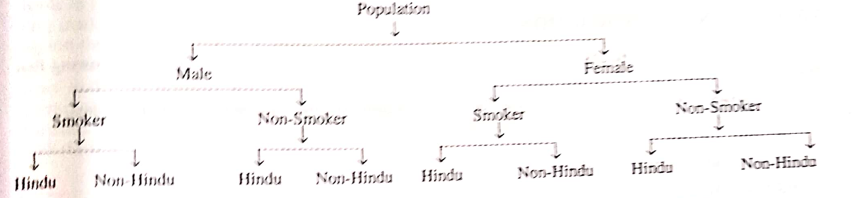
Another example of manifold classification

Slide 41
Quantitative Classification : If the data are classified on the basis of phenomenon which is capable of quantitative measurement like age, height, price, production etc., it is termed as quantitative classification. The quantitative phenomena under study is called variable and hence it is also knows as classification by variable.
For eg: Daily earnings (in ’00 Rs. )of 60 departmental stores
Daily earnings | Number of stores
Upto 100 | 20
101-200 | 18
201-300 | 14
301-400 | 8

Slide 42
Tabulation
Tabulation is one of the most important device of presenting the data in a condensed form to furnish maximum information in minimum possible space.
Tabulation is the final stage in collection and compilation of data and opens the gateway for further statistical analysis and interpretations.

Slide 43
Format of a blank table
Table Number: 1
Title
(Head Note, if any)
Footnote:
Source note:
Stub | Caption |  |  |  |  | Total
 | Sub-heads |  | Sub-Heads
 | Column head | Column head | Column head | Column head | Column head
 | Body of the table
Total

Slide 44
Types of Tables
Types of Tables
On the basis of objectives/purpose
On the basis of nature of enquiry
On the basis of coverage
General purpose
Special purpose
Original
Derived
Simple
Complex

Slide 45
General Purpose (reference) table and Special purpose (Summary) table
General purpose tables are systematically arranged data usually in chronological order in a form which is suitable for ready reference and record with out any intension of comparative studies, relationship or significance of figures.
Eg: Most of the tables prepared by government agencies.
Special Purpose tables are of analytical nature and are prepared with the idea of making comparative studies, studying relationship and significance of figures provided by the data. In such tables, interpretive figures like ratios, percentages etc. are used in order to facilitate comparisons.

Slide 46
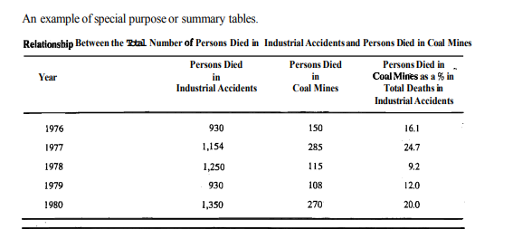
Special Purpose/Summary table

Slide 47
Original (Primary) and Derived(Derivative) table
In a primary table, the statistical facts are expressed in the original form. It therefore contains absolute and actual figures and are not rounded numbers or percentages.
On the other hand, derived table is one which contains figures and results derived from the original or primary data. It express the information in terms of aggregates or statistical measures like average, dispersion, skewness etc.
For instance, time series data is expressed in a primary table but a table expressing trend values, seasonal and cyclic variations is a derived table.

Slide 48
Simple and complex tables
In a simple table, data are classified with respect to a single characteristic and accordingly it is also termed as one-way table.
Eg: Agricultural output of different countries(in kg per hectare)
If the data are grouped into different classes with respect to two or more characteristic, or criterion simultaneously, we get a complex(manifold) table.
Eg: Distribution of number of students in a college w.r.t.
age and gender
Distribution of a given population w.r.t. age, gender
and literacy

Slide 49
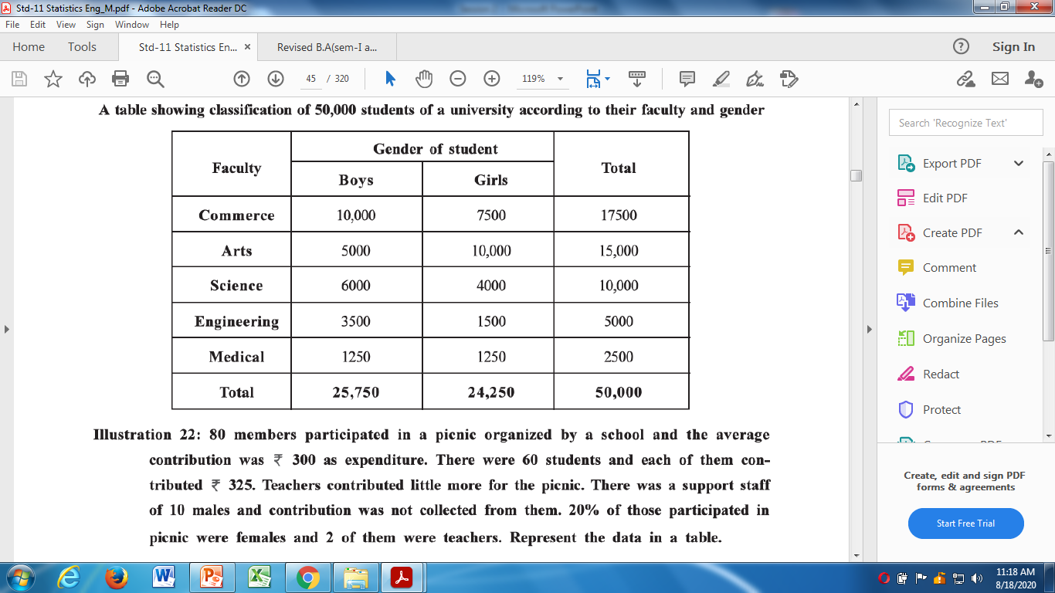
A simple illustration of table

Slide 50
Data Quality and Issues
Session 5
27/11/2020

Slide 51
Data Quality Issues
Success of ML largely depends on the quality of the data.
A data which has the right quality helps to achieve better prediction accuracy in case of supervised learning.
There are multiple factors which lead to the data quality issues.

Slide 52
Data Quality Issues
Incorrect sample set selection
Random responding and motivated mis- responding
Who are the true respondents?
Errors in data collection
Missing values
Extreme values

Slide 53
Incorrect sample set selection
The data may not reflect normal or regular quality due to incorrect selection of sample set.
Eg: sales transaction from a festive period to predict for future period.
If you are interested in studying the effects of smoking on a particular outcome, you must define what it means to be a smoker which helps make the research more precise.
For example do you include people who just smoke occasionally? What about those smokers who previously used tobacco but have stopped?

Slide 54
Can data cleaning fix sampling problems?
Unfortunately in many cases, poor sampling cannot be corrected by data cleaning.
The goal of sampling is to gather data on whatever phenomenon is being studied in such a way as to make the best case possible for withdrawing inferences about the population of interest.

Slide 55
Random Responding, Motivated Misresponding
Let me ask you “How are you doing today”. Ever notice that some people tend to flip between extremes(e.g. wonderful or horrible) while others seem to be more stable (e.g. OK or fine) no matter what is going on. This is an example of one sort of Response set, where individual tend to vary in a narrow band around the average or vary around extremes.

Slide 56
Response Set
A response set is a strategy people use (consciously or otherwise)when responding to educational tests, questionnaires, or things like psychological tests (or even questions paused in casual conversation in the above example).
Researchers should pay more attention to response sets and effects of random responding which can substantially increase probability of Type II errors.

Slide 57
Common types of Response Sets
Random Responding
Malingering and Dissimulation
Social desirability
Other response styles
Response styles peculiar to educational testing

Slide 58
Common types of Response Sets
Random responding : Random responding is a response set in which individuals respond with little pattern or thought. The behaviour adds substantial error variance to analysis which completely make ineffective the usefulness of responses.
This may be motivated by lack of preparation, reactivity to observation, lack of motivation to cooperate with testing or disinterest.
If we are not careful, participants with lower motivation to perform at their maximum level may increase the odds of Type II errors masking real effects of our research through response sets such as random responding.

Slide 59
Malingering is a response set where individuals falsify and exaggerate answers to appear weaker or more medically or psychologically symptomatic, often motivated by the goal of receiving services they would not otherwise be entitled to.
Someone might pretend to be injured so they can collect an insurance settlement or obtain prescription medication.
Dissimulation refers to a response set in which respondents falsify answers in an attempt to be seen in more negative or more positive side than honest answers can provide.
These response sets are common in psychological test like “Do you have suicidal thought?”

Slide 60
Social Desirability : Social desirability is related to malingering and dissimulation in that it involves altering responses in systematic ways to achieve a desired goal. In this case to behave in the same way as most other people in a group or society, the respondent want to “look good” to the examiner.
Other response styles : Other response styles such as acquiescence and criticality are response patterns wherein individuals are more likely to agree with (acquiescence) or disagree with (criticality) questionnaire items in general, regardless of the nature of the item.

Slide 61
Response styles peculiar to educational testing: The biases peculiar to tests of academic mastery (often multiple choice) include :
(a) response bias for particular column on multiple
choice items
(b)bias for or against guessing when uncertain of the
correct answer.

Slide 62
Detecting random responding in your research
An important issue is whether we can be confident that what we call random responding truly is random?
There is a large and well developed literature on how to detect many different types of response sets.
Examples include addition of particular types of items to detect social desirability , altering instructions to respondents in particular ways, creating equally desirable items worded positively and negatively, use item response theory (ITR) to explicitly estimate a guessing parameter.

Slide 63
Item Response Theory
One application of IRT has implications for identifying random responders using the theory to create person-fit indices.
The idea behind this approach is to quantitatively group individuals by their pattern of responding and then use these groupings to identify individuals who deviate from an expected pattern of responding. Also it is possible to estimate the guessing parameter.
One drawback of ITR is that it generally requires large samples.

Slide 64
Data Quality Issues and Data Cleaning: Identifying outliers
Session 6
02/12/2020

Slide 65
Data Cleaning To illustrate the need for cleaning up of data, consider the data given below
Customer Id | Zip | Gender | Income | Age | Marital Status | Transaction amount
1001 | 10048 | M | 75,000 | C | M | 5000
1002 | J2S7K7 | F | -40,000 | 40 | W | 4000
1003 | 90210 |  | 10,000,000 | 45 | S | 7000
1004 | 6269 | M | 50,000 | 0 | S | 1000
1005 | 55101 | F | 99,999 | 30 | D | 3000

Slide 66
Introduction
Authors spend a great deal of time describing the importance of the study, the research methods, analysis etc., but rarely mention having screened their data for outliers or extreme observations.
Jumping from data collection to data analysis is a wrong practice.
Some techniques such as “robust” procedures and non-parametric tests (which do not require an assumption of normally distributed data) exists in the literature.
Parametric tests are rarely robust to violations of distributional assumptions.

Slide 67
What are extreme scores
An outlier(extreme score) is generally considered to be a data point that is far outside the norm for a variable or population.
It is an observation that deviates so much from other observations in the data.
It is not to say that extreme scores are not of value, but they should be examined more closely in depth.
The literature on extreme scores reveals two broad categories: outliers and fringeliers

Slide 68
Outliers and Fringeliers
Outliers are clearly problematic that they are far from the rest of the distribution.
Fringeliers are those scores around +/-3.0 standard deviations from the mean, which represents a good rule of thumb for identifying scores that merit further examination.
Why we are concerned with scores around +/-3.0 SD from the mean?

Slide 69
What cause extreme scores
It can arise from different mechanisms or causes.
Extreme scores from data errors like human errors
Extreme scores from Intentional or motivated misreporting
(eg: responses to income, study time, educational attainment etc.)
Extreme scores from sampling error or bias: A sampling error is a statistical error that occurs when an analyst does not select a sample that represents the entire population of data and the results found in the sample do not represent the results that would be obtained from the entire population
Extreme scores from faulty distributional assumptions.

Slide 70
How extreme values affect statistical analysis?
Increase error rates and decrease the quality and precision of your results
Decrease power of the test by altering skew or kurtosis of a variable
Seriously bias or influence estimates that may be of substantive interest such as mean, SD etc.

Slide 71
Identification of extreme scores
Empirical rule
Box and whisker plot
Standardized residuals in case of bivariate and multivariate extreme scores.
Mahalanobis distance or cook’s distance

Slide 72
Empirical Rule
Empirical Rule : This is an important rule of thump used to state the approximate percentage of values that lie within a given number of standard deviations from the mean of a set of data if the data are normally distributed.
Distance from the mean Values within distance
μ ± 1σ 68%
μ ± 2σ 95%
μ ± 3σ 99.7%
(Based on the assumption that the data are approximately normally distributed)

Slide 74
Box-and-Whisker Plots
A box-and-whisker plot (Box-plot) is a diagram that utilizes the upper and lower quartiles along with the median and the two most extreme values to depict a distribution graphically.
The plot is constructed by using a box to enclose the median along a continuum to the lower and upper quartiles.
Quartiles : Quartiles are measures of central tendency that divide a group of data in to four parts. The three quartiles are denoted as Q₁,Q₂ and Q₃.

Slide 75
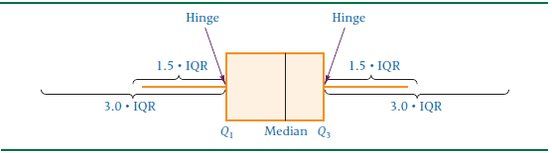
Box-and-Whisker Plots (contd…)
From the lower and upper quartiles, lines referred to as whiskers are extended out from the box toward the outermost data values.
The box end points (Q₁ and Q₃) are referred to as the hinges of the box.

Slide 76
Five Number summary
Box and Whisker plot is determined by five specific numbers referred to as five number summary
1.The median (Q₂)
2. The lower quartile (Q₁)
3. The upper quartile (Q₃)
4. The smallest value (Min)
5. The largest value (Max)

Slide 77
Box-and-Whisker Plots (contd…)
Next the value of Inter Quartile Range (IQR= Q₃-Q₁) is to be computed. IQR includes the middle 50% of the data and should equal to the length of the box.
A whisker, a line segment is drawn from the lower hinge of the box outward to the smallest data value and a second whisker is drawn from the upper hinge of the box outward to the largest data value.
At a distance of 1.5IQR outward from the lower and upper quartiles are what are referred to as inner fences.

Slide 78
The inner fences are established as follows.
Q₁-1.5 IQR
Q₃+1.5 IQR
If data falls beyond the inner fences, then outer fences can be constructed.
Q₁-3 IQR
Q₃+3 IQR
Values in the data distribution that are outside the inner fences are referred to as mild outliers.
Values that are outside the outer fences are called extreme outliers.
Thus one of the main uses of Box-and-Whisker plot is to identify outliers.

Slide 79
Data Quality and Issues (contd…) Identifying outliers and handling missing data
Session 7
04/12/2020

Slide 80
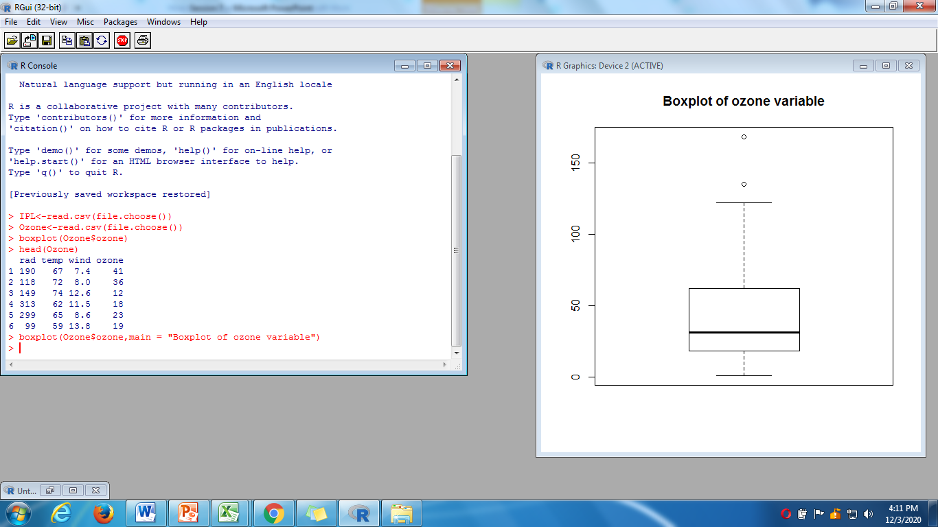
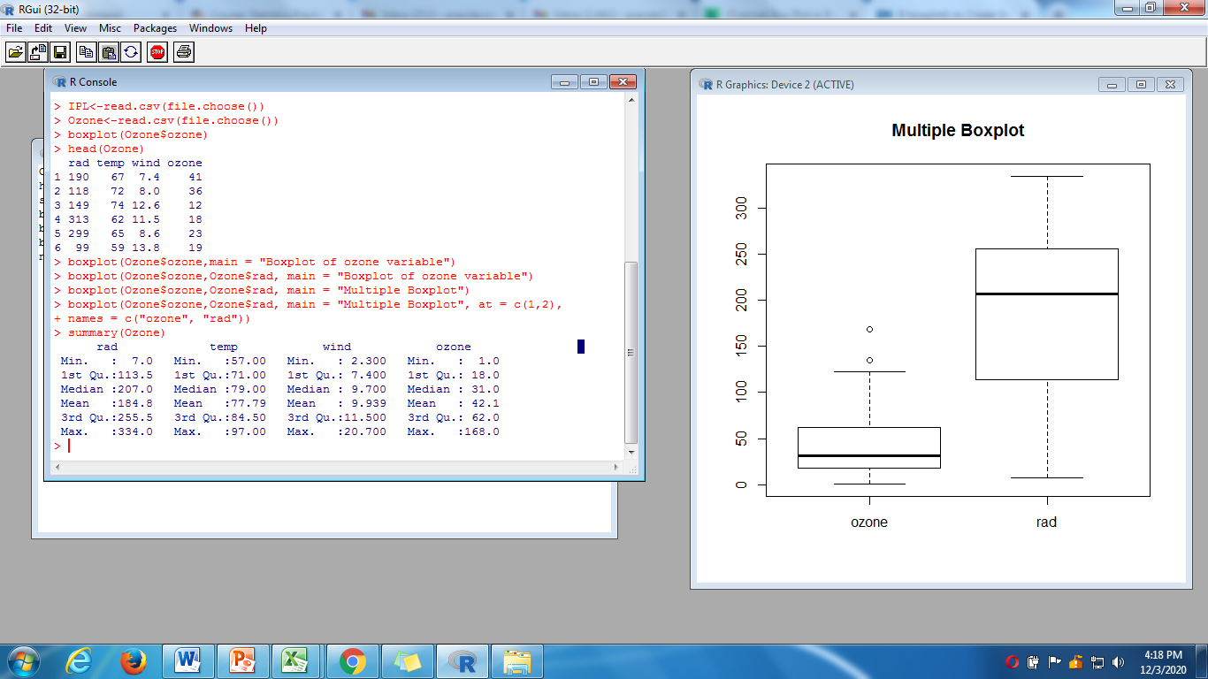
The data “ozone” contains variables ozone(ozone concentration), wind(wind speed), temp(air temperature) and rad(intensity of solar radiation). The objective is to know how is ozone concentration related to wind speed, air temperature and the intensity of solar radiation.

Slide 81
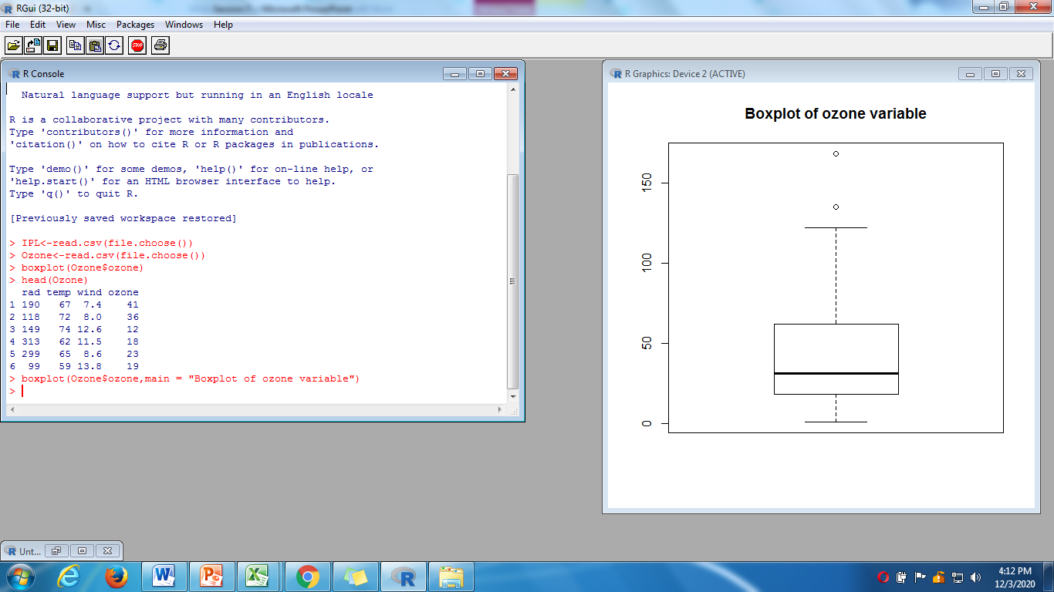
Boxplot:R zone

Slide 82
Multiple Box-plot : R zone

Slide 83
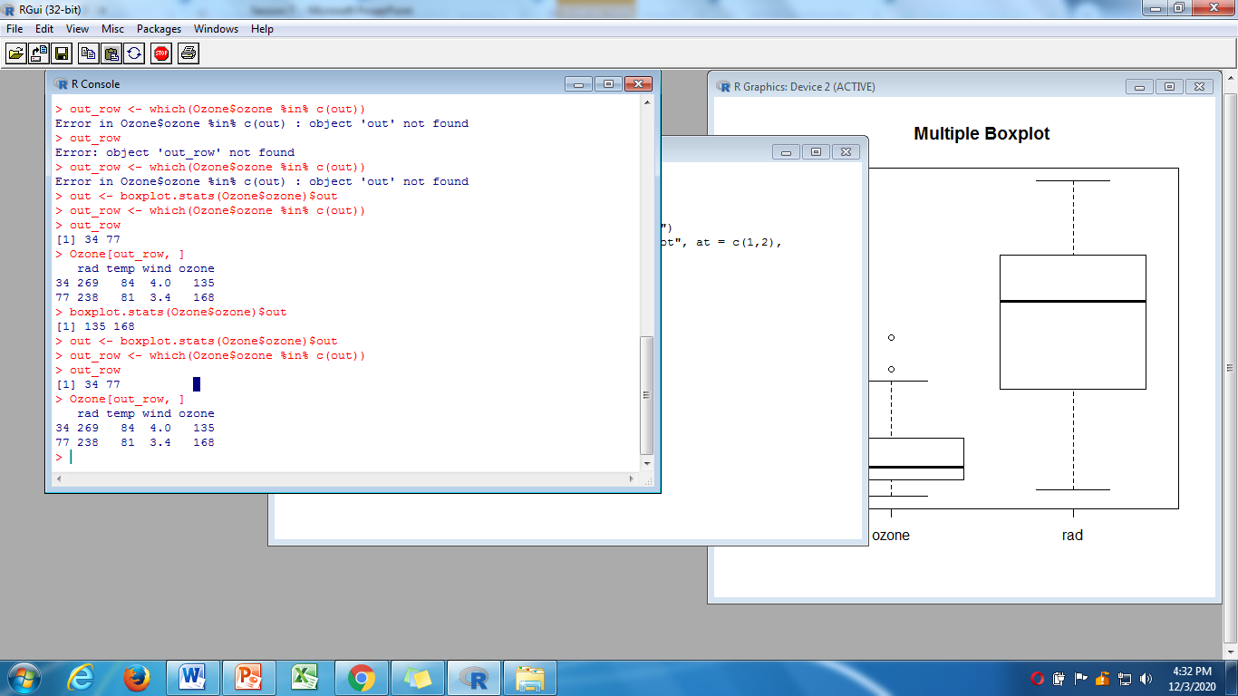
Identifying outlier value and corresponding row number and printing

Slide 84
Missing Data
In a dataset, one or more data elements may have missing values in multiple records.
It may be due to a person who is collecting the sample data or by the responder, primarily due to his/her unwillingness to respond or lack of understanding needed to provide a response.
It is rare that a database contains no missing values at all. How the analyst deals with the missing data may change the outcome of the analysis.
There are multiple strategies to handle missing values.

Slide 85
Need for Imputation of Missing data
It is important to learn methods for handling missing data that will not bias the results.
Delete Records Containing Missing Values?
Not necessarily a best approach
Deleting records creates biased subset
Valuable information in other fields lost

Slide 86
Methods to Handle Missing Data
Replace Missing Values with User-defined Constant
Missing numeric values replaced with 0.0.
Missing categorical values replaced with “Missing”.
Replace Missing Values with Mode or Mean
Mode of categorical variables.
Mean for numeric variables.

Slide 87
Methods to Handle Missing Data
Replace Missing Values with Random Values from the observed distribution of the variable
Values randomly taken from underlying distribution.
Method superior compared to mean substitution.
Measures of location and spread remain closer to original.

Slide 88
Methods to Handle Missing Data
Replace Missing values with imputed values.
Estimate the missing value using regression given that all other attributes for a particular record.
Estimate the missing value using multivariate imputation by chained equation.

Slide 89
The Imputation Method
For continuous variables, the imputation is done with regression.
Estimate the missing value by taking the variable as response given that all other values.
It uses stepwise regression (forward elimination) to include significant variables.
For categorical variables, classification algorithm such as CART will be used.
The general question asked is “What would be the most likely value for this missing record, given all the other attributes for a particular records?”.

Slide 90
Imputation by Stepwise Regression
First prepare the data for multiple regression, specially categorical variables must be converted to dummy variables.
Let Y is the response variable and (X₁, X₂, …., X_{p}) are p-predictors.
Let the predictor X₂ has a missing value corresponding to a record say R7.
Consider the predictor X₂ as response variable and all the original predictors (minus X₂) represent predictors.
Do not include the original response variable Y as predictor for imputation.
Apply stepwise variable selection method on X₂.
The model starts with no predictors, then the most significant predictor is entered into the model, followed by next most significant predictor and so on till all significant predictors have been entered into the model and no further predictors have been dropped.
Once the model is built, use the predictors to estimate the value of X₂.

Slide 91
Imputation by MICE-Procedure
How do we impute if there are missing values in different predictors?-MICE.
MICE assumes the data are Missing at Random (MAR) which means that the probability of a missing value depends only on the observed values and can be predicted using them.
Procedure (Azur, et.al., 2011)
Step-1: Replace (impute) the missing values in each variable with temporary “place holder” values derived from the observed values of the variables. This can be done by mean imputation.
Step-2: The “place holder” mean imputations for one variable (say X₁) are set back as missing.
Step-3: Regress X₁ based on other variables using the observed values. Drop all records where X₁ is missing during the model fitting.
Step-4: The missing values for X₁ are then replaced with predictions from the regression model.
Step-5: Repeat steps 2-4 for each variable that has missing values.

Slide 92
MICE Cont’d.
Applying Steps 2-5 once for each variable constitute a “cycle”.
MICE requires a number of such cycles and at each cycle the missing values are updated.
Generally, the number of cycles is taken as 5 which is specified in advance.
Retain the imputed values corresponding to the final cycle.
Note that assumptions on regression model must be taken care off.

Slide 93
Reference
Azur, M.J., Stuart, E.A., Frangakis, C., & Leaf, P.J. (2011), Multiple Imputation by Chained Equations: What is it and how does it work?, International Journal of Methods in Psychiatric Research, 20(1), 40-49.

Slide 94
Missing value imputation MICE: How does it work?
Session 8
07/12/2020

Slide 95
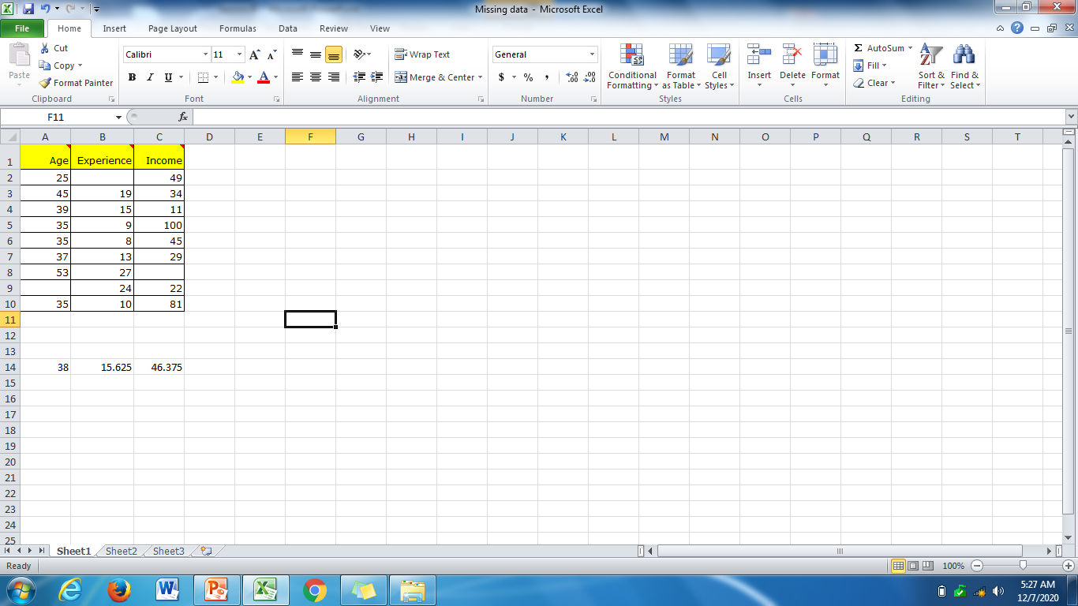
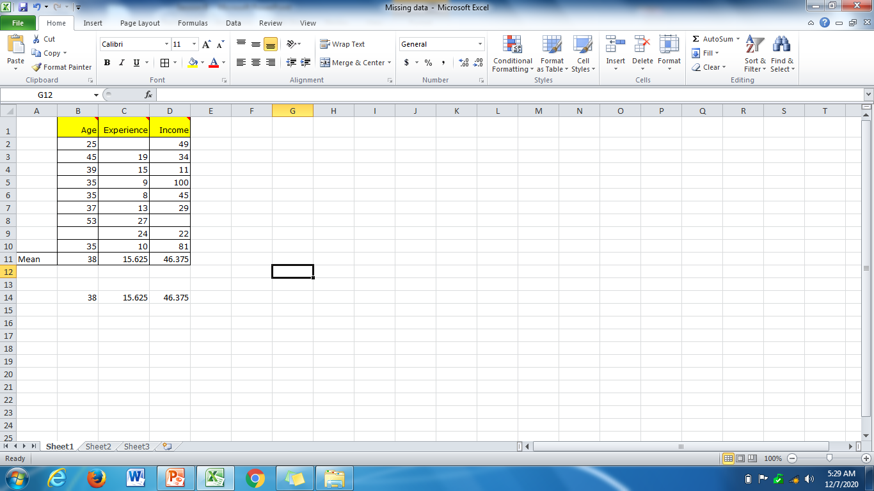
A simple illustration
Impute column mean values.

Slide 96
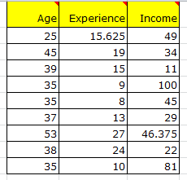
Impute mean values as place holders: Base data Are the values reliable?

Slide 97
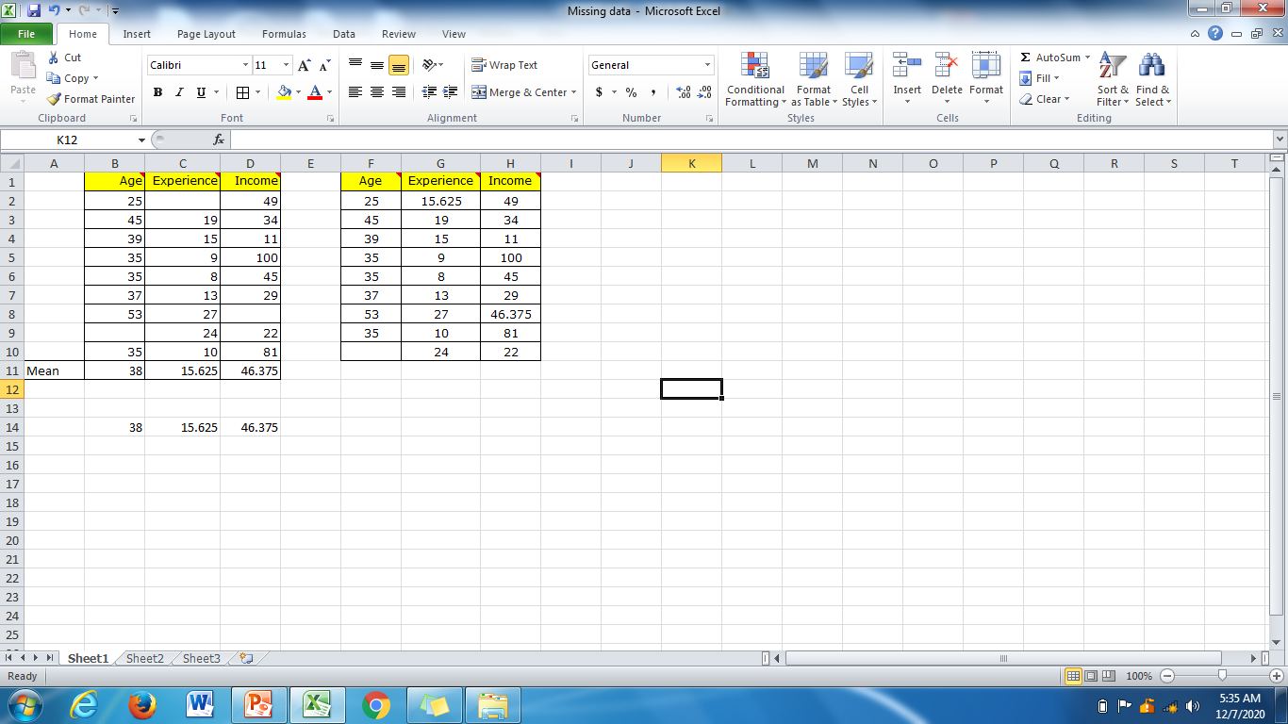
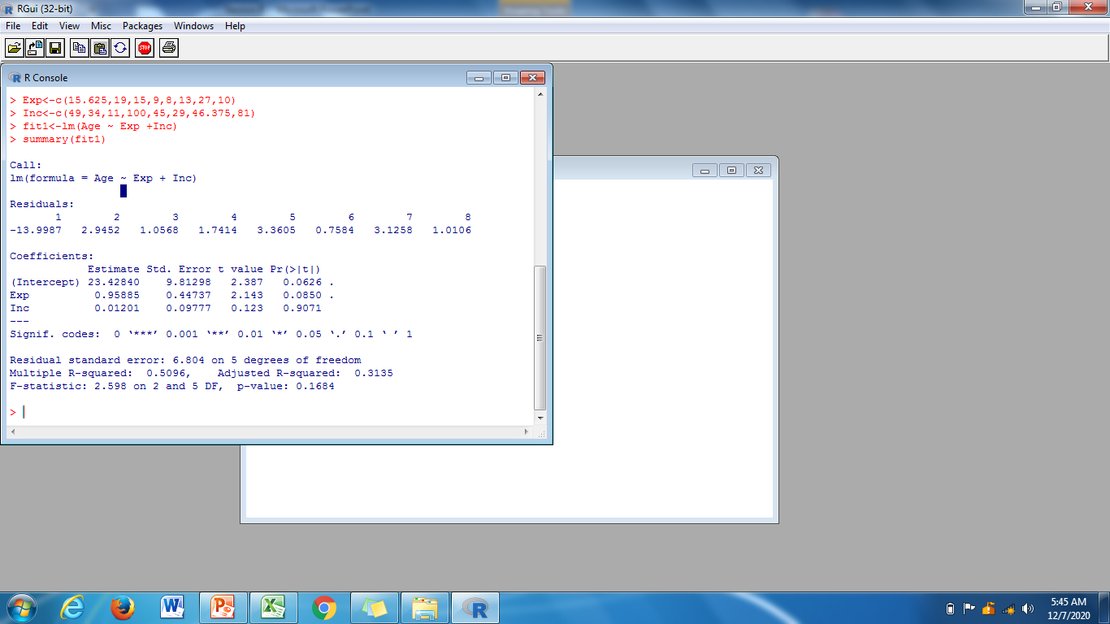
Remove place holder from left most column and fit a model with age as dependent and experience and income as predictors but with 8 observations.
The estimated regression equation is
Age= 23.43820 +0.95885(Exp)+0.01201(Inc)
Age= 46.70

Slide 98
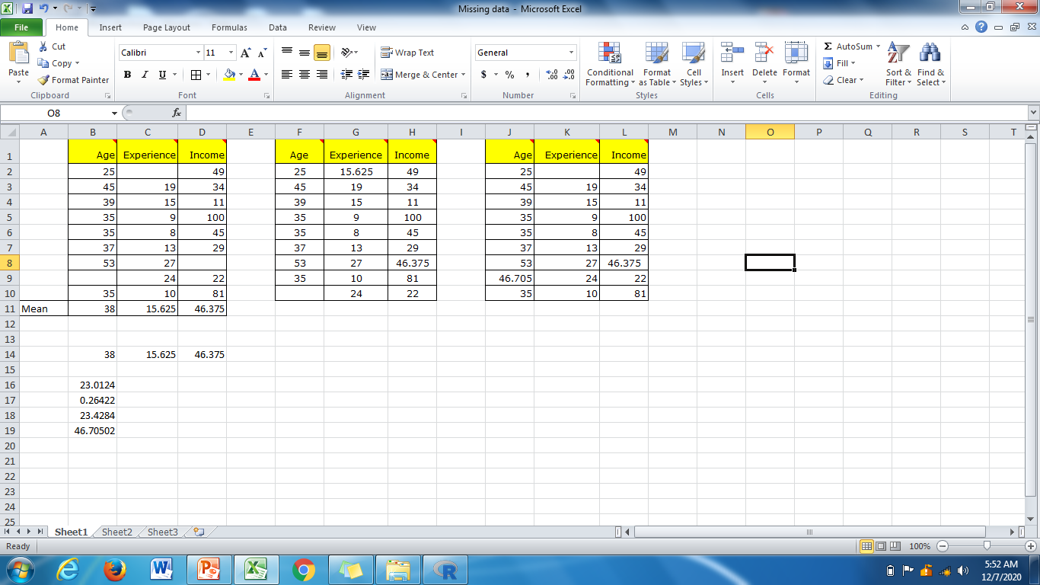
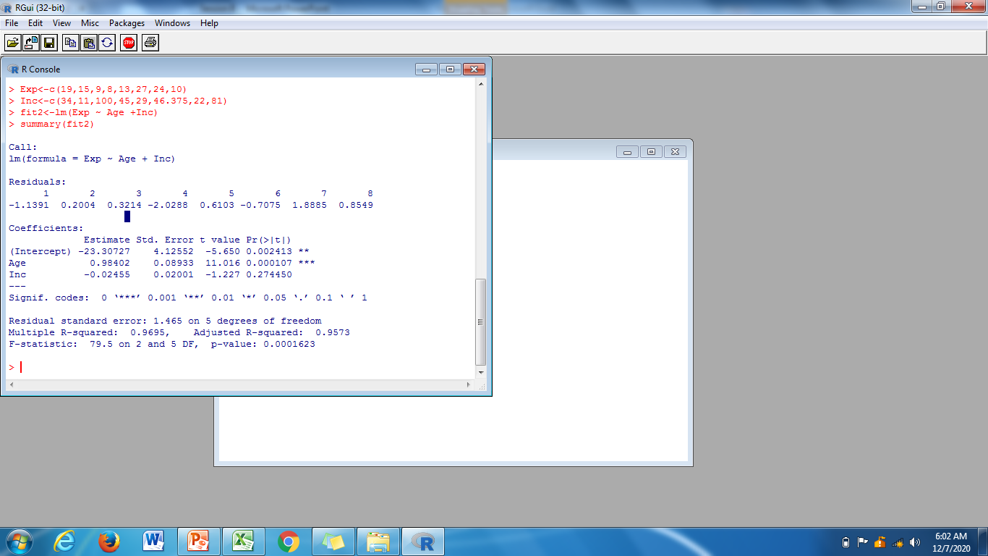
Impute the estimated Age value in the first column and remove the place holder of second column ‘Experience’. Now repeat the procedure by taking ‘Experience’ as dependent variable and age and Income as independent variables.
The estimated regression equation is
Exp = -23.30727 + 0.98402(age) -0.02455(Inc)
Exp. = 0.09028

Slide 99
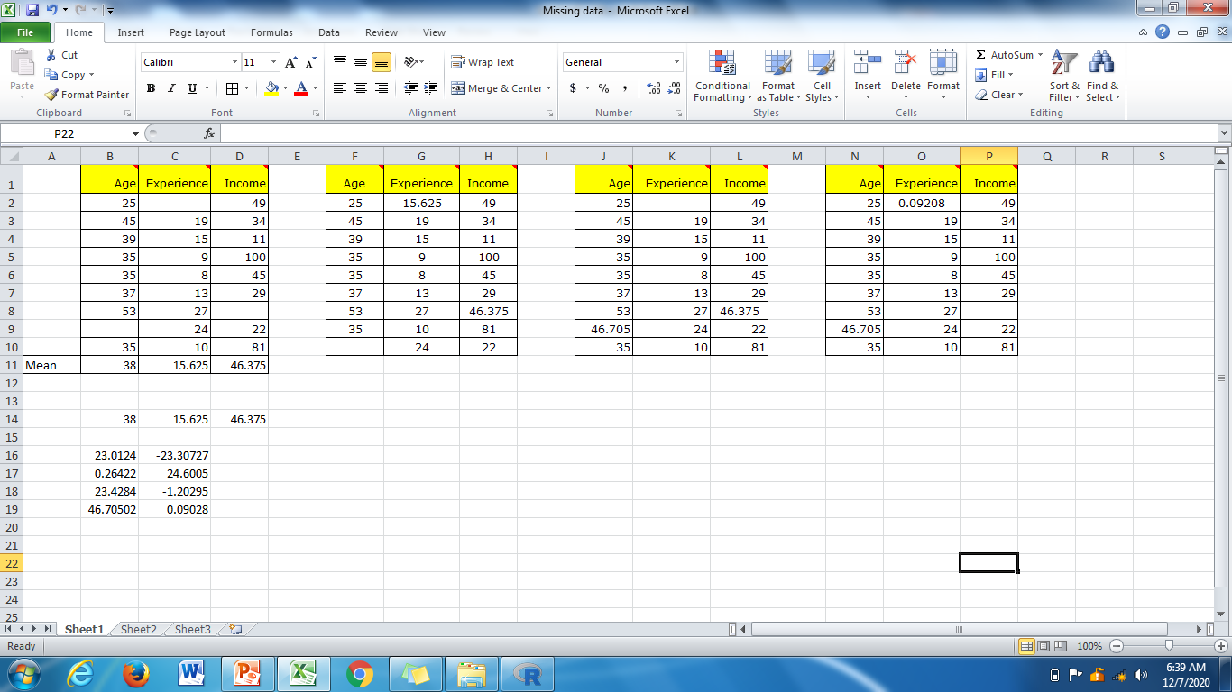

Impute the estimated Experience value in the second column and remove the place holder of third column ‘Income’. Now repeat the procedure by taking ‘Income’ as dependent variable and age and Experience as independent variables.
The estimated regression equation is
Inc. = -128.005+7.642(age) -8.971(Exp)
Inc = 34.804

Slide 100
Now 1 cycle completed the following imputed values

Slide 101
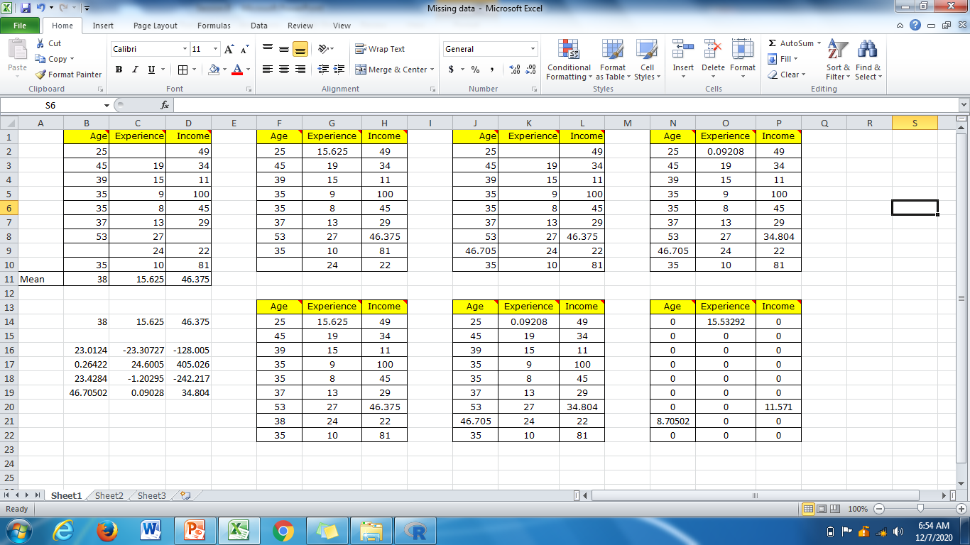
Now find the difference between base data and the first cycle data

Slide 102
MICE procedure (contd…)
The whole procedure described here repeats for a number of cycles and at each cycle the missing values are updated.
Retain the imputed values corresponding to the final cycle.
How do we know final cycle?
Note that assumptions on regression model must be taken care off.

Slide 103
Pre-processing of data

Slide 104
Data transformation
Variables tend to have ranges that vary greatly from each other. For example, if we are interested in major league baseball, players’ batting averages will range from 0 to less that 0.400, while the number of homeruns hit in a season will range from 0 to around 70. Such case, greater variability in homeruns will dominate the lesser variability in batting averages.
One should normalize their numerical variables in order to standardize the scale of effect each variable has on the results.
Min-Max Normalization: X_{mm} = X-min(x)/Range(x).

Slide 105
Z-score
Z-score is obtained by taking the difference between field value and the field mean value and scaling this difference by S.D. of the field values.
Z Score Standardization: Z score = $\frac{X−mean(X)}{S.D(X)}$
Cars data : variable weight
Mean | 3005.490
Min | 1613
Max | 4997
Range | 3384
S.D | 852.646

Slide 106
Z-score
For the vehicle weighing only 1613 pounds, the Z-score is
Z score = $\frac{X−mean(X)}{S.D(X)}$= $\frac{1613−3005.490}{852.646}$ =~ -1.63
For ‘average’ vehicle (if any)
Z score = $\frac{X−mean(X)}{S.D(X)}$= $\frac{3005.490−3005.490}{852.646}$ =0
For the heaviest car, the z-score is
Z score = $\frac{X−mean(X)}{S.D(X)}$= $\frac{4997−3005.490}{852.646}$ =~ 2.34

Slide 107
Data pre-processing
Session 9
09/12/2020

Slide 108
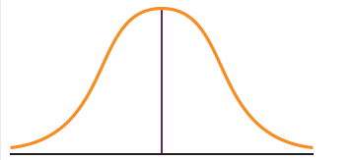
Transformations to achieve Normality
Some data mining algorithms and statistical methods require that the variables be normally distributed.

Slide 109
Transformations to achieve Normality
To make our data more normally distributed, we must first make it symmetric, which means eliminating the skewness.
To eliminate skewness, one can apply a transformation to the data.
Common transformations are log transformation (ln), the square root transformation and the inverse square root transformation

Slide 110
Contd…
After achieving symmetry, to check for normality, we construct a normal probability plot.
Don’t forget to de-transform the data
y=1/√x, then x=1/y^{2.}

Slide 111
Flag (Indicator/dummy) variables
Some analytical methods such as regression require predictors to be numeric. Thus analysts wishing to use categorical predictors in regression need to recode the categorical variable into one or more flag variables.
For example the categorical predictor ‘gender’ taking values for female and male could be recorded into the flag variable as follows
If gender= female then gender_flag=0;
If gender=male then gender_flag=1

Slide 112
Contd…
When a categorical predictor takes k≥ 3 possible values, then define k-1 dummy variables and use the unassigned category as the reference category. For example if a categorical predictor region has k=4 possible categories, {north, east, south, west}, then the analyst could define the following
k-1=3 flag variables.
north_flag: If region=north then north_flag=1; otherwise
north_flag=0
east_flag: If region=east then east_flag=1; otherwise
east_flag=0
south_flag: If region=south then south_flag=1; otherwise
south_flag=0
The flag variable for the west is not needed, instead the unassigned category becomes the reference category

Slide 113
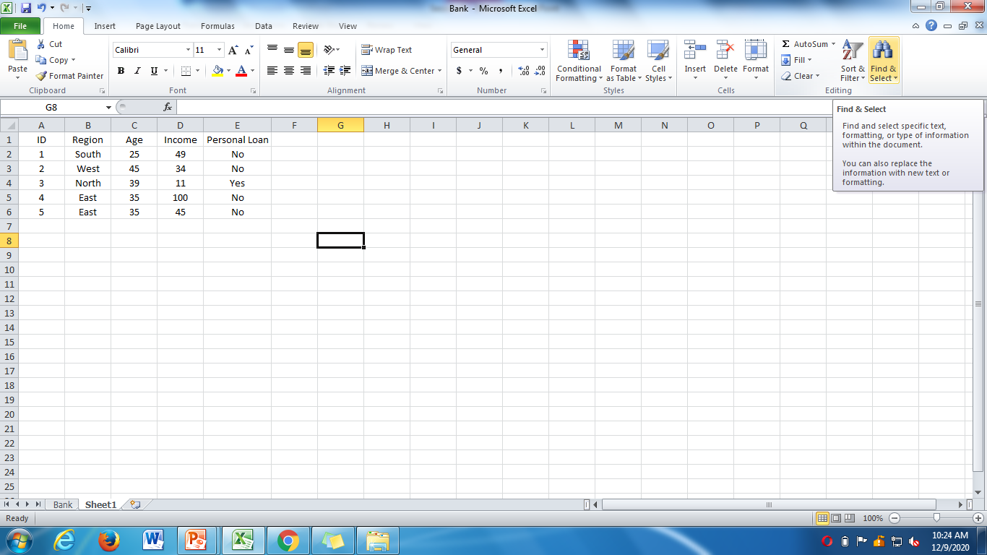
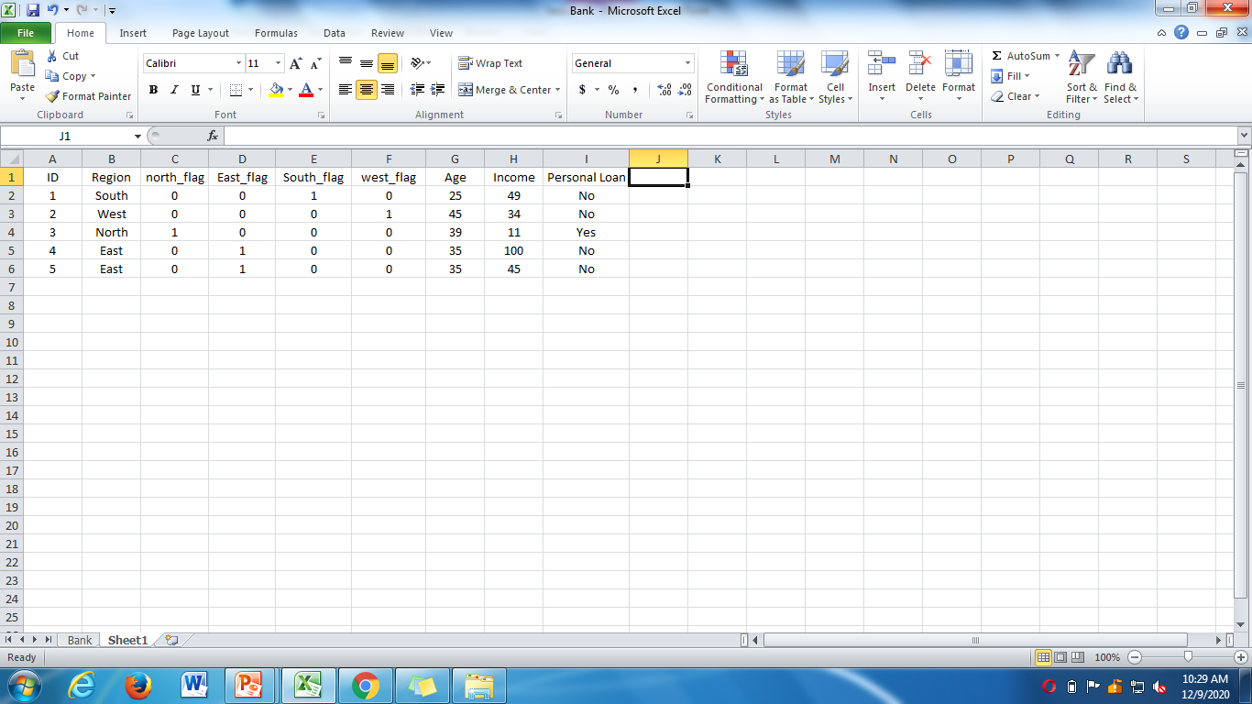
A simple example how flag variables will work

Slide 114
Transforming Categorical variables into Numerical variables
Common error
The algorithm now erroneously thinks the following.
The four regions are ordered.
West>South>East>North
West is 3 times closer to south compared to north and so on.
Region | Region number
North | 1
East | 2
South | 3
West | 4

Slide 115
Contd…
Data analyst should avoid transforming categorical variables to numerical variables except for that are clearly ordered. For example, survey response taking values always, usually, sometimes, never. In this case one could assign numerical values to the responses.
Survey response | Number
Always | 4
Usually | 3
Sometimes | 2
Never | 1

Slide 116
Reclassifying categorical variables
Often Categorical variable will contain too many easily analyzable field values. For example the predictor ‘state’ could contain 50 different field values. In such a case the analyst should reclassify the field values. i.e., 50 states could each be reclassified as a variable region containing field values Northeast, Southeast, North Central, Southwest and West. Thus instead of 50 different field values, the analyst will face with only 5.

Slide 117
Getting to know the dataset
With unknown large databases, the analyst often prefer to use Exploratory Data Analysis (EDA) or Graphical Data Analysis
EDA allows the analyst to
Examine the inter relationships among the attributes
Identifying interesting subsets of the observations
Develop an initial idea of possible associations amongst the predictors as well as between predictors and target variables.
Notes:
For example, in the customer support database, it is important to identify subsets of tickets having service time which is too large (or too small) when compared with the service time of the rest of the tickets

Slide 118
Dimension Reduction Methods
The use of too many predictor variables to model a relationship with a response variable can unnecessarily complicate the interpretation of the analysis. Also retaining too many variables may lead to overfitting.
Dimension reduction methods have the role of using the correlation structure among the predictor variables to accomplish the following
To reduce the number of predictor items
To help ensure that these predictor items are independent
To provide a framework for interpretability of the results.

Slide 119
Principal Components Analysis (PCA)
PCA seeks to explain the correlation structure of a set of predictor variables, using a smaller set of linear combinations of these variables. These linear combinations are called components. The total variability of a dataset produced by the complete set of m variables can often be mostly accounted for by a smaller set of k linear combinations of these variables, which would mean that there is almost as much information in the k components as there is in the original m variables.

Slide 120
Factor Analysis (FA)
FA is related to Principal Components but the two methods have different goals. Principal Components seek to identify orthogonal linear combinations of the variables, to be used either for descriptive purposes or to substitute a smaller number of uncorrelated components for the original variables. In contrast , FA represents a model for the data.

Slide 121
Presentation of Data
Session 10
11/12/2020

Slide 122
Presentation of Data
Data in raw form are usually not easy to use for decision making
Some type of organization is needed
Table
Diagram and Graph
Depends on the variable being summarized

Slide 123
Presentation of Data
Categorical
Variables
Numerical
Variables
Frequency distribution
Bar chart
Pie chart
Pareto diagram
Frequency distribution
Line chart
Histogram and ogives
Scatter plot

Slide 124
Presentation for Categorical Variables
Categorical Data
Tabulating Data
Diagrammatic representation of Data
Frequency Distribution Table
Bar Diagram
Pie Diagram
Pareto Diagram

Slide 125
Describing Data Sets
Qualitative Data are nonnumerical
Major Discipline
Political Party
Gender
Eye color
Summarized in two ways:
Class Frequency
Class Relative Frequency

Slide 126
Class
A class is one of the categories into which qualitative data can be classified
Class Frequency
Class frequency is the number of observations in the data set that fall into a particular class
Frequency Distribution
It is a summary technique that organizes data into classes and provides in tabular form a list of the classes along with the number of observations in each class.

Slide 127
Example: Adult Aphasia
Table: Data on 22 Adult Aphasias
Subject | Type of Aphasia | Subject | Type of Aphasia
1 | Broca’s | 12 | Broca’s
2 | Anomic | 13 | Anomic
3 | Anomic | 14 | Broca’s
4 | Conduction | 15 | Anomic
5 | Broca’s | 16 | Anomic
6 | Conduction | 17 | Anomic
7 | Conduction | 18 | Conduction
8 | Anomic | 19 | Broca’s
9 | Conduction | 20 | Anomic
10 | Anomic | 21 | Conduction
11 | Conduction | 22 | Anomic

Slide 128
Table: Frequency Distribution of Data on 22 Adult
Aphasias
Type of Aphasia | Frequency
Anomic | 10
Broca’s | 5
Conduction | 7
Total | 22

Slide 129
Class Relative Frequency
Class frequency divided by the total number of observations in the data set
Class Percentage
Class relative frequency multiplied by 100

Slide 130
Table: Frequency, relative frequency, and class percentage on 22 Adult Aphasias
Type of Aphasia | Frequency | Relative Frequency | Class Percentage
Anomic | 10 | 10/22 = .455 | 45.5%
Broca’s | 5 | 5/22 = .227 | 22.7%
Conduction | 7 | 7/22 = .318 | 31.8%
Total | 22 | 22/22 = 1.00 | 100%

Slide 131
Diagrammatic representation of Qualitative variables
Bar Chart
Pie chart
Pareto diagram

Slide 132
One dimensional diagrams; Bar diagrams
Bar diagrams are one of the easiest and the most commonly used devices of presenting most of the business and economic data. These are one dimensional diagrams because in such diagrams only one dimension, say height or length of the bar is taken into account to present the given values.
Types of bar diagrams.
a) Simple bar diagram
b) Subdivided or component bar diagram
c) Percentage bar diagram
d) Multiple bar diagram.

Slide 133
a) Simple bar diagram
It is the simplest of the bar diagrams and is used for comparative study of values of a single variable or single classification of data.
Here the magnitudes of the observations are represented by the height of the bars.
Remark: If there are large number of items or values of the variable under study then instead of bar diagram, line diagram may be drawn.

Slide 134
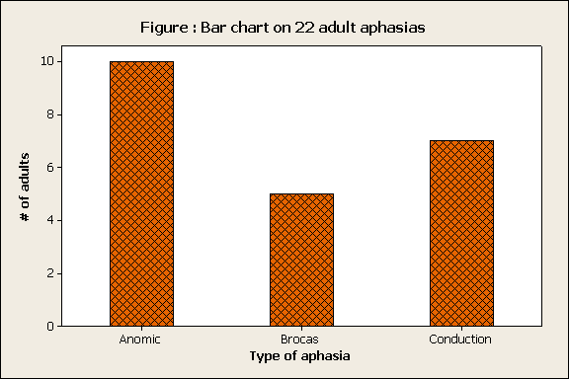
Bar Chart Example: Data on 22 Adult Aphasias
A diagramatic representation of information in the form of bars.
Bars of equal width are drawn to represent different categories, with the length of each bar being proportional to the number or frequency of occurrence of each category.

Slide 135
b)Subdivided or component bar diagram
A limitation of the simple bar diagram is that it study only one item of a characteristic or classification at a time.
Subdivided bar diagram is useful not only for presenting several items of a variable diagramatically but also enable us to make a comparative study of different parts or components among themselves and also to study the relationship between each component and the whole.
In general subdivided bar diagrams are used if total magnitude of the given variable has to be divided into various parts or components. First bar representing total is drawn . Then it is divided into various segments, each segment representing a given component of the total . Different shades, colours or designs are used to distinguish various components .
Remark : subdivided bar diagram is not suggested if the number of components exceed 10 .

Slide 136
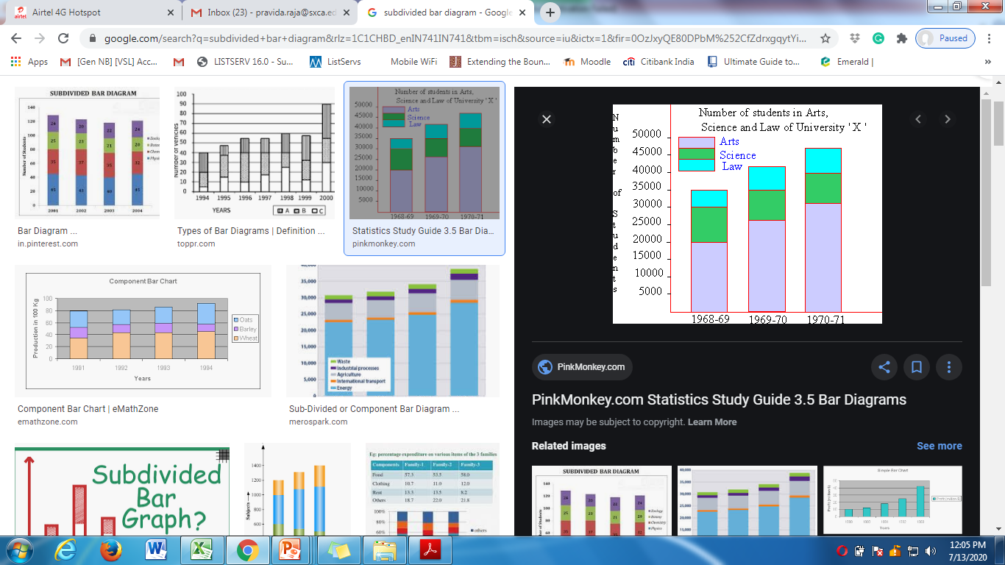
Subdivided bar diagram

Slide 137
c)Percentage bar diagram
Subdivided or component bar diagram presented on a percentage basis gives percentage bar diagram.
These are useful for diagrammatic portrayal of the relative change in the data and hence highlight the relative importance of the various component parts to the whole.
The total for each bar is taken as 100 and the value of each component is expressed as percentage of the respective totals. It is quite convenient and useful for comparing two or more sets of data .

Slide 138
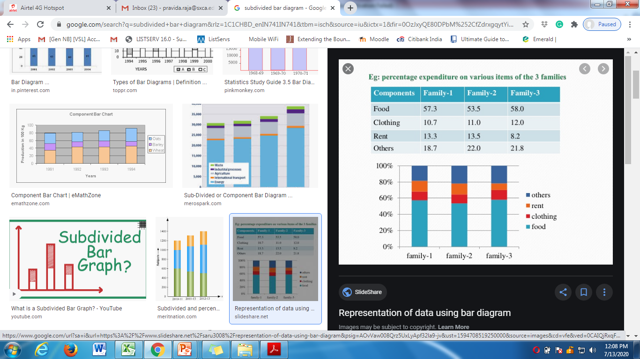
Percentage bar diagram

Slide 139
d)Multiple bar diagram
As discussed earlier one limitation of simple bar diagram is the representation of a single characteristic. If two or more sets of interrelated variables are to be presented, multiple bar diagrams are used.
The technique of drawing multiple bar diagrams are same as that of simple bar diagram except that here a set of adjacent bars ( one for each variable) is drawn.
Proper and equal spacing is given between different sets of the bars. To distinguish different bars, a set different shades may be used.

Slide 140
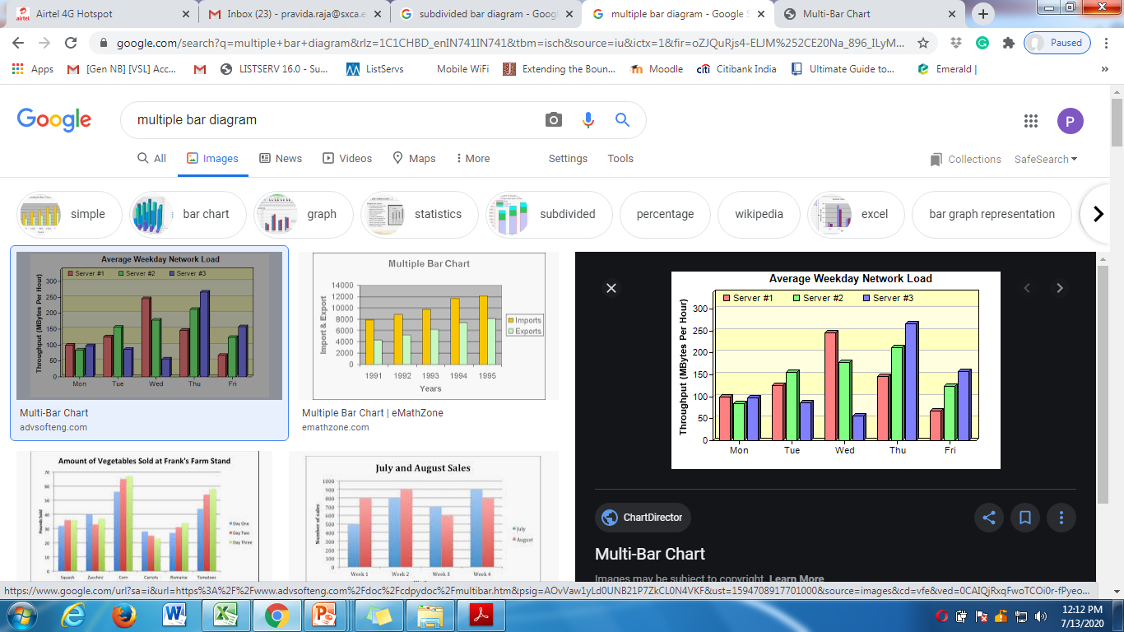
Multiple bar diagram

Slide 141
Presentation of Data(contd…)
Session 11
14/12/2020

Slide 142
Two-dimensional diagrams

Slide 143
Introduction
We know that in one dimensional diagrams magnitude of the observations are represented by only one of the dimensions say height or length of the bar, while the width of the bar is arbitrary and uniform. However in two dimensional diagrams magnitude of the given observations are represented by the area of the diagram.
Thus in two dimensional diagrams the length as well as width of the bars will have to be considered.
Two dimensional diagrams are also known as area diagram or surface diagram.
Some of the commonly used two dimensional diagrams are rectangles and pie diagrams .

Slide 144
Pie diagrams
Just as subdivided or percentage bar or rectangles are used to represent the total magnitude and its various components, the circle may be divided into various sections or segments say sectors representing certain proportion or percentage of various component parts.
Sub divided circle is known as pie diagram or angular or circular diagram.

Slide 145
Steps of construction of pie diagram
1.Express each of the component values as a percentage of the respective total.
2. The percentage of component parts obtained in step 1 can be converted to degrees by multiplying each of them by 3.6.
3. Draw a circle of appropriate radius and represent the components sector wise.
4. Different sectors to be distinguished with different shades.

Slide 146
Pie chart representing students’ opinion

Slide 147
Pareto Diagram
Used to portray categorical data
A bar chart, where categories are shown in descending order of frequency.
One of the important aspects of total quality management is the constant search for causes of problems in products and processes.
A graphical technique for displaying problem causes is Pareto Analysis. Pareto analysis is a quantitative tallying of the number and types of defects that occur with a product or service. Analysts use this tally to produce a vertical bar chart that display the most common types of defects ,ranked in order of occurrence from left to right. This bar chart is called a Pareto Chart.

Slide 148
Pareto Diagram Example
Example: 400 defective items are examined
for cause of defect:
Source of Manufacturing Error | Number of defects
Bad Weld | 34
Poor Alignment | 223
Missing Part | 25
Paint Flaw | 78
Electrical Short | 19
Cracked case | 21
Total | 400

Slide 149
Pareto Diagram Example
(continued)
Step 1: Sort by defect cause, in descending order
Step 2: Determine % in each category
Source of Manufacturing Error | Number of defects | % of Total Defects
Poor Alignment | 223 | 55.75
Paint Flaw | 78 | 19.50
Bad Weld | 34 | 8.50
Missing Part | 25 | 6.25
Cracked case | 21 | 5.25
Electrical Short | 19 | 4.75
Total | 400 | 100%

Slide 150
Pareto Diagram Example
(continued)
Step 3: Show results graphically
% of defects in each category (bar graph)
cumulative % (line graph)

Slide 151
Graphs to Describe Numerical Variables
Numerical Data
Frequency Distributions and
Cumulative Distributions
Histogram
Ogive

Slide 152
Frequency Distribution
One particularly useful tool for grouping data is the frequency distribution, which is a summary of data presented in the form of class intervals and frequencies.
The way of tabulating the data of a variable and their respective frequencies side by side is called a frequency distribution of that data.
We discuss the following cases
Discrete (ungrouped) frequency distribution
Grouped frequency distribution
Continuous frequency distribution

Slide 153
Discrete (ungrouped) frequency distribution
Here first we arrange the data in ascending/descending order.
In the first column, we place the possible values of the variable
Then we count the number of times each value of the variable occurs. In the second column a vertical bar(called Tally mark) is put against the number whenever it occurs.
After putting the tally mark for all the values in the data, we count the number of times each value is repeating and write it against the corresponding number in the third column.

Slide 154
Discrete (ungrouped) frequency distribution
Marks of 10 students are given below. Construct a discrete frequency distribution.
Arrange the data : 20,25,30,33,45,45,45,64,64,70.
70 | 45 | 33 | 64 | 45
25 | 64 | 45 | 30 | 20
Marks | Tally | Frequency
20 | | | 1
25 | | | 1
30 | | | 1
33 | | | 1
45 | ||| | 3
64 | || | 2
70 | | | 1
Total | 10 | 10

Slide 155
Grouped frequency distribution
Here classify the data into different classes(or class intervals) by dividing the entire range of the values of the variable into a suitable number of groups which is called classes.
Then we record(count) the number of observations in each group or class.
The grouped frequency distribution of earlier example of marks are done below.
Marks | No.of students
20-35 | 4
36-50 | 3
51-65 | 2
66-80 | 1
Total | 10

Slide 156
Continuous frequency distribution
While dealing with a continuous variable, it is not desirable to present the data in to a form which we have seen earlier.
For example, if we consider the ages of a group of students in a college, then grouped frequency distribution into the classes 18-20, 21-23, 24-26 etc. will not be correct. Why?
In such situation, we form continuous class intervals like Below 20, 20 or more but less that 23 etc.
The presentation of data into continuous classes of above type along with corresponding frequencies is known as continuous frequency distribution.

Slide 157
Unit-2 Basic Statistics
Frequency Distribution
Session 12
16/12/2020

Slide 158
Why Use Frequency Distributions?
A frequency distribution is a way to summarize data
The distribution condenses the raw data into a more useful form.
Allows for a quick visual interpretation of the data

Slide 159
Basic principles for forming a grouped frequency distribution
The following are the general guidelines
1.Types of classes: The classes should be clearly defined and should be non-overlapping.
2. Number of classes : Usually number of classes should not be greater than 15 and should not be less than 5 based on the total frequency, nature of the data etc.
There is one rule exists which is known as Sturge’s rule which is as follows.

Slide 161
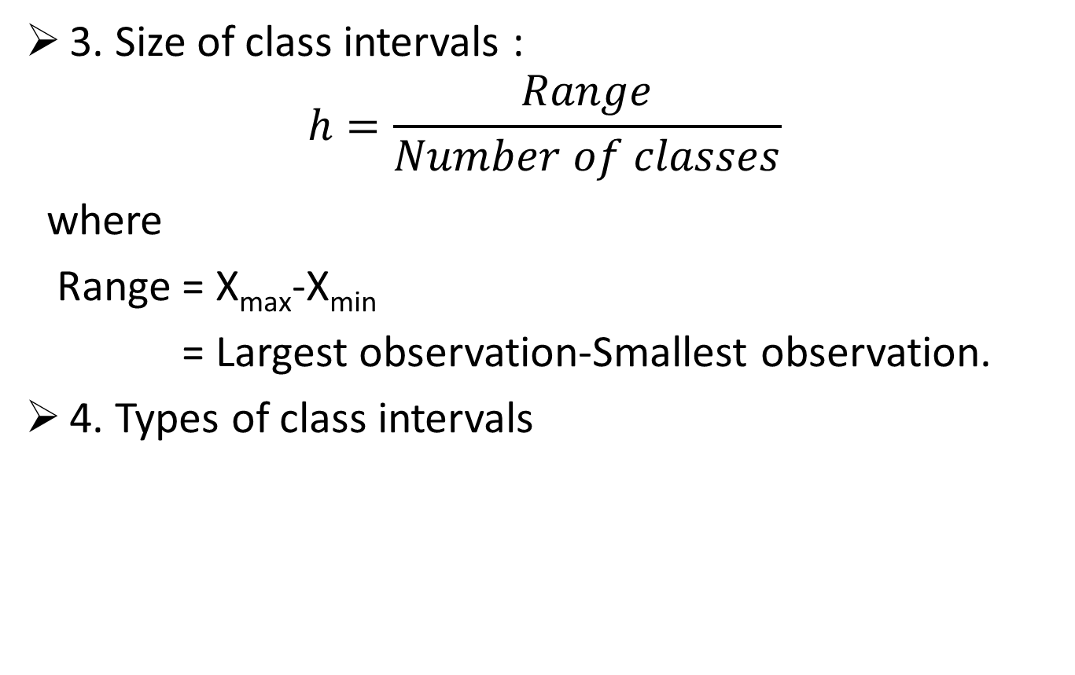
Basic principles for forming a grouped frequency distribution
3. Size of class intervals :
$$h=\frac{Range}{Number of classes}$$
where
Range = X_{max}-X_{min}
= Largest observation-Smallest observation.
4. Types of class intervals
Inclusive
Open-end
Unequal
Exclusive

Slide 162
4. Types of class intervals
(a) Inclusive type classes : The classes of the type 30-39,40-49,50-59 etc. in which both the upper and lower limits are included in the class are called Inclusive classes.
(b) Exclusive type classes : The classes of the type 15-20, 20-25,25-30 etc. in which the upper limit of the classes are excluded from the respective classes are called Exclusive classes.
(c)Open-end classes: The classification is termed as ‘open end classification’ if the lower limit of the first class or the upper limit of the last class are not specified . For example classes like marks less than 20, age above 60 are open-end classes.

Slide 163
4. Types of class intervals (contd…)
(d) Unequal Class interval : When the width of the classes are NOT equal in a particular frequency distribution, such type of classes are unequal classes.
Examples are 0-10, 10-30, 30-80,80-100 etc.

Slide 164
Converting inclusive class to exclusive class(continuous class)
The upper and lower class limits of new exclusive type classes are called class boundaries.
If d is the gap between the upper limit of any class and lower limit of succeeding class, the class boundaries for any classes are given by
Upper class boundary = Upper class limit +[1(d)/2]
Lower class boundary =Lower class limit –[1(d)/2]
Marks (Inclusive) | Class boundary (Exclusive)
20-24 | 19.5-24.5
25-29 | 24.5-29.5
30-34 | 29.5-34.5

Slide 166
Mid-value (class mark)
As the name suggests, the mid-value or class mark is the value of the variable which is exactly at the middle of the class.
The mid-value of any class is obtained on dividing the sum of upper and lower class limits (class boundaries) by 2.
Mid-value of a class = ½[Lower class limit+ Upper class limit] = ½[ Lower class boundary +Upper class boundary].
Marks | Class boundary | Mid value
20-24 | 19.5-24.5 | 22
25-29 | 24.5-29.5 | 27
30-34 | 29.5-34.5 | 32

Slide 167
Frequency Distribution Example
Example: An analyst randomly selects 20 winter days and records the daily high temperature
24, 35, 17, 21, 24, 37, 26, 46, 58, 30,
32, 13, 12, 38, 41, 43, 44, 27, 53, 27

Slide 168
Frequency Distribution Example
Sort raw data in ascending order: 12, 13, 17, 21, 24, 24, 26, 27, 27, 30, 32, 35, 37, 38, 41, 43, 44, 46, 53, 58
Find range: 58 - 12 = 46
Select number of classes:
k =1+3.322log10(20)=5(apprx)
Compute interval width: 9.2 (round up) ~ 10
Determine interval boundaries: 10 but less than 20, 20 but less than 30, . . . , 50 but less than 60
Count observations & assign to classes

Slide 169
Frequency Distribution Example
Data in ordered array:
12, 13, 17, 21, 24, 24, 26, 27, 27, 30, 32, 35, 37, 38, 41, 43, 44, 46, 53, 58
Class interval | frequency | Relative frequency | Percentage
10-20 | 3 | 0.15 | 15
20-30 | 6 | 0.3 | 30
30-40 | 5 | 0.25 | 25
40-50 | 4 | 0.2 | 20
50-60 | 2 | 0.1 | 10
Total | 20 | 1 | 100

Slide 170
Cumulative frequency distribution and graphical presentation of data
Session 13
18/12/2020

Slide 171
Cumulative frequency distribution
A frequency distribution simply tells us how frequently a particular value of the variable is occurring.
However if we want to know the total number of observations getting a value ‘less than’ or ‘more than’ a particular value of the variable, the normal frequency table fails.
Cumulative frequency distribution is a modification of the given frequency distribution, and is obtained on successively adding the frequencies of the values of the variable according to a certain law.
The frequencies so obtained are called ‘cumulative frequencies’ (c.f).

Slide 172
Types of cumulative frequency distribution
cumulative frequency distribution
Less than cf
More than cf

Slide 173
Less than c.f.
Less than c.f. for any value of the variable (class) is obtained on adding successively the frequencies of all the previous values (classes), including the frequency of the variable against which the totals are written, provided the values(classes) are arranged in ascending order of magnitude.
In a less than cumulative frequency distribution, the cumulative frequencies are in ascending order.

Slide 174
More than c.f.
The more than c.f. is obtained similarly by finding the cumulative totals of frequencies starting from the highest value of the variable (class) to the lowest value (class).
In more than cumulative frequency distribution, cumulative frequencies are in descending order.
Remarks
1: In fact ‘less than’ and ‘more than’ words also include ‘equality sign’.
2: Cumulative frequency is of particular importance in computation of median, quartiles etc.

Slide 175
The Cumulative Frequency Distribution
Example: 20 winter days daily high temperature
Data in ordered array:
12, 13, 17, 21, 24, 24, 26, 27, 27, 30, 32, 35, 37, 38, 41, 43, 44, 46, 53, 58.
Class interval | frequency | Percentage | Less than c.f | Greater than c.f
10-20 | 3 | 15 | 3 | 20
20-30 | 6 | 30 | 9 | 17
30-40 | 5 | 25 | 14 | 11
40-50 | 4 | 20 | 18 | 6
50-60 | 2 | 10 | 20 | 2
Total | 20 | 100

Slide 176
Graphic representation of data
The most commonly used graphs for charting a frequency distribution are
Histogram
Frequency polygon
Frequency curve
Ogive/Cumulative frequency curves

Slide 177
Histogram
It is one of the most commonly used devices for continuous frequency distribution. Usually the variate takes values (class) are taken along the X axis and the frequencies along the Y axis.
It is possible to construct histogram with equal classes intervals and unequal classes.
If the classes are of equal interval, erect a rectangle with height proportional to the corresponding frequency of the class. The area under the histogram is the total frequency of the distribution as distributed through out different classes.

Slide 178
Histogram (contd…)
If the classes are of unequal width, erect a rectangle with height proportional to the frequency density where
Frequency density = frequency of the class
Class width
Remark:
The interval endpoints are shown on the horizontal axis
The vertical axis is either frequency, relative frequency, or percentage

Slide 179
Histogram Example
Interval
Frequency
10 but less than 20 3
20 but less than 30 6
30 but less than 40 5
40 but less than 50 4
50 but less than 60 2
(No gaps between bars)
0 10 20 30 40 50 60 70
Temperature in Degrees

Slide 180
How Many Class Intervals?
Many (Narrow class intervals)
may yield a very rough with sharp distribution
with gaps from empty classes
Can give a poor indication of how frequency varies across classes
Few (Wide class intervals)
may compress variation too much and yield a blocky distribution
can obscure important patterns of variation.
(X axis labels are upper class endpoints)

Slide 181
Frequency Polygon
It is another device of graphic presentation of a frequency distribution (continuous, grouped or discrete) . In case of discrete frequency distribution, frequency polygon is obtained on plotting the frequencies on the vertical axis (Y-axis) against the corresponding values of the variable on the horizontal axis (X-axis) and joining the points so obtained by straight lines.
In case of grouped/continuous frequency distribution, frequency polygon may be drawn two ways.

Slide 182
Frequency polygon without constructing Histogram
X-axis: 1 cm =10 units,
Y-axis:1cm=10 units

Slide 183
Frequency Curve
A frequency curve is a smooth free hand curve drawn through the vertices of a frequency polygon. The area enclosed by the frequency curve is same as that of histogram or polygon but its shape is smooth one without sharp edges.

Slide 184
Frequency curve
X-axis: 1 cm =10 units,
Y-axis:1cm=10 units

Slide 185
Comparison of Histogram and frequency polygon
Histogram
Polygon
A two dimensional figure with a collection of adjacent rectangles
For comparative studies, we need to draw different histograms
Suitable adjustment should be done for drawing histogram with unequal class intervals
A line graph
Two or more frequency polygon can be drawn on the same graph for comparative studies.
A continuous curve and hence may be used to determine rate of change, slope etc.

Slide 186
Graphical presentation of Data(contd..)
Session 14
21/12/2020

Slide 187
Ogive(Cumulative frequency curves)
This is a graphical presentation of cumulative frequency distribution of a continuous variable. It consists in plotting the cumulative frequencies(along the y axis) against the class boundaries (along x axis) .
Since there are two types of c .f. distribution, we have accordingly two types of ogives.
(i) Less than ogive
(ii) More than(greater than) ogive

Slide 188
Less than ogive
This consist in plotting the less than cumulative frequencies against the upper class boundaries of the respective classes. The points so obtained are joined by a smooth free hand curve to give less than ogive.
It is an increasing curve slopping upwards from left to right .
Less than ogive should start on the left with cumulative frequency zero at the lower boundary of the first class .

Slide 189
More than ogive
In more than ogive the more than cumulative frequencies are plotted against the lower class boundaries of the respective classes. The points so obtained are joined by a smooth free hand curve to give more than ogive.
It is a decreasing curve and slopes downward from left to right.
Note:
1. it is possible to draw less than and more than ogive in a single graph.
2. These are useful for graphic computation of partition values say median, quartiles, deciles, percentiles etc .

Slide 190
The Ogive Graphing Cumulative Frequencies
Upper boundary point
Cumulative Percentage
Interval
Less than 10 10 0
10 but less than 20 20 15
20 but less than 30 30 45
30 but less than 40 40 70
40 but less than 50 50 90
50 but less than 60 60 100
Interval endpoints

Slide 191
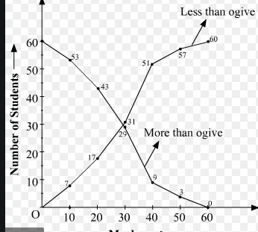
less than and more than ogive in a single graph.

Slide 192
Measures of Central tendency

Slide 193
Describing Data Numerically
Describing Data Numerically
Central Tendency
Variation
Arithmetic Mean
Range
Median
Interquartile Range
Mode
Variance
Standard Deviation
Coefficient of Variation

Slide 194
Summary Definitions
The central tendency is the extent to which all the data values group around a typical or central value.
The variation is the amount of dispersion, or scattering, of values

Slide 195
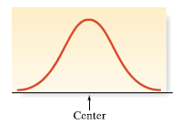
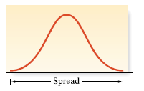
Summarizing Data Sets
Numerical Measures of Central Tendency
Central tendency is the value
or values around which the data
tend to cluster
Variability shows how strongly
the data cluster around that (those)
value(s)

Slide 196
Measures of central tendency (ungrouped data)

Slide 197
Measures of Central Tendency: The Mean
The arithmetic mean (often just called “mean”) is the most common measure of central tendency
For a sample of size n:
Pronounced x-bar
The i^{th} value
Sample size
Observed values

Slide 198
Measures of Central Tendency: The Mean
The most common measure of central tendency
Mean = sum of values divided by the number of values
Affected by extreme values (outliers)
0 1 2 3 4 5 6 7 8 9 10
0 1 2 3 4 5 6 7 8 9 10
Mean = 3
Mean = 4

Slide 199
Example: During a two week period 10 houses were sold(in $) in Fancytown.
The “average” or mean price for this sample of 10 houses in Fancytown is $295,000

Slide 200
Example: During a two week period 10 houses were sold in
(in $)Lowtown.
The “average” or mean price for this sample of 10 houses in Lowtown is $295,000
Outlier

Slide 201
Measures of Central Tendency: The Median
In an ordered array, the median is the “middle” number (50% above, 50% below)
Not affected by extreme values
0 1 2 3 4 5 6 7 8 9 10
0 1 2 3 4 5 6 7 8 9 10
Median = 3
Median = 3

Slide 202
Measures of Central Tendency: Locating the Median
The location of the median when the values are in numerical order (smallest to largest):
If the number of values is odd, the median is the middle number
If the number of values is even, the median is the average of the two middle numbers
Note that is not the value of the median, only the position of
the median in the ranked data

Slide 203
Example: Consider the Fancytown data. First, we put the data in numerical increasing order to get
231,000 285,000 287,000 294,000 297,000
299,000 312,000 313,000 315,000 317,000
Since there are 10 (even) data values, the median is the mean of the two values in the middle.

Slide 204
Example: Consider the Lowtown data. We put the data in numerical increasing order to get
93,000 95,000 97,000 99,000 100,000
110,000 113,000 121,000 122,000, 2,000,000
Since there are 10 (even) data values, the median is the mean of the two values in the middle.

Slide 205
Measures of Central Tendency: The Mode
Value that occurs most often
Not affected by extreme values
Used for either numerical or categorical data
There may be no mode
There may be several modes
0 1 2 3 4 5 6 7 8 9 10 11 12 13 14
0 1 2 3 4 5 6
No Mode
Mode = 9

Slide 206
Review Example
Five houses on a hill by the beach
House Prices: $2,000,000 500,000 300,000 100,000 100,000

Slide 207
Measures of Central Tendency: Review Example
House Prices: $2,000,000
$500,000 $300,000 $100,000 $100,000
Sum $3,000,000
Mean: ($3,000,000/5)
= $600,000
Median: middle value of ranked data = $300,000
Mode: most frequent value = $100,000

Slide 208
Measures of Central Tendency: Which Measure to Choose?
The mean is generally used, unless extreme values (outliers) exist.
The median is often used, since the median is not sensitive to extreme values. For example, median home prices may be reported for a region; it is less sensitive to outliers.
In some situations it makes sense to report both the mean and the median.

